Slide 1


Slide 2


What is it?
Bi-product of Char production,
  Essentially condensed gases from the heated feedstock.
A complex liquid of over 200 compounds,
  Composition of compounds vary depending on feedstock and char process (temperature/time),
  Mostly water.
Used extensively throughout Asia for farming replacement of agri-chemicals

Slide 3

Why use Wood Vinegar
Potential to increase seed germination rates,
Better uptake of fertilisers and trace elements allowing for lower use of agri-chemicals,
Sustainable feedstock,
Value adds to growing Char manufacturing industry,
High density liquid “freight vs coverage”,
Fits into normal farming applications – spraying.

Slide 4
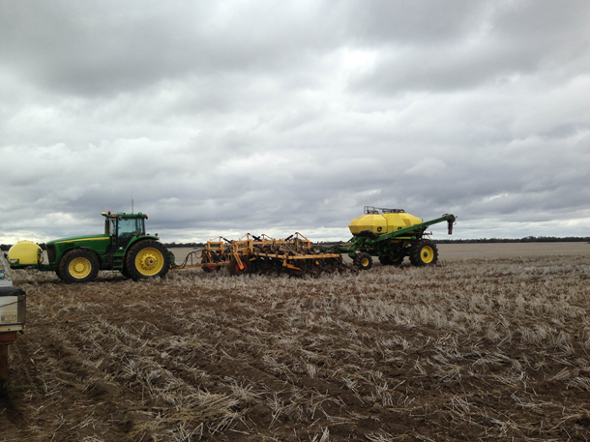
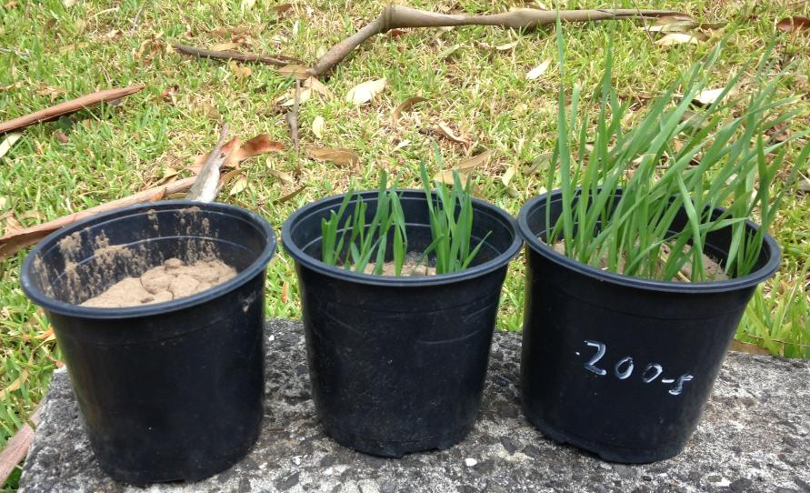
Pot Trial – Wheat and Soil from Come-By-Chance, NSW
Same Rainfall for each pot.
Seeds sprayed with 1:200 Wood Vinegar : Water on planting
No treatment
Seeds sprayed with water on planting
We have done hundreds of successful pot trials using Wood Vineagr and now an increasing number of larger field trials from vineyards to macadamias and many more.
Last year we tried to improve the seed strike rate on an 800ha wheat crop, unfortunately a drought did not allow us to see any results.
You can see from the pot trials above using soil from the wheat crop the benefits that Wood Vinegar had on seed germination.

Slide 5
Challenges in making WV mainstream
Defining use for large variety of applications,
Educating user benefits of a “new” product,
Sourcing and manufacturing a consistent product made from natural feedstock to achieve dependable and repeatable results,
Government approval process for a complex composition of compounds – required for certain possible uses like pesticides.

Slide 6
Wood Vinegar Australia’s Mission
Create Awareness and Value of Wood Vinegar in Australian Agriculture,
Form relationships and work directly with farmers on practical field trials,
Collect practical field data on large range of plant varieties and applications,
Gain support/funding for Scientific Research.

Slide 7
“Better Farming Naturally”
We are seeking support for trials and can supply small or large quantities of Wood Vinegar with a consistent quality. Please feel free to contact us.
www.woodvinegar.com.au

Slide 8
